Slide 1
Physical limitations of signal conversion

Slide 2
Why this matters for CSE Students
Understanding the physical limitations of signal conversion is crucial for "Power Budgeting."
If the light signal becomes too weak due to fiber loss,
the photocurrent will drop below the noise floor, leading to a high Bit Error Rate (BER).

Slide 3
Concept:
In an optical communication system, the receiver's job is to convert light (photons) back into electricity (electrons).
Quantum Efficiency (η): This represents the "success rate" of the photodiode. A 70% efficiency means that for every 100 photons that hit the detector, only 70 successfully generate an electron-hole pair to create current.
Responsivity (R): This is a practical measure for engineers.
While quantum efficiency is a ratio of particles, Responsivity tells us exactly how many Amperes of current we get for every Watt of light power.
It is wavelength-dependent because the energy of a photon changes with its color (wavelength).

Slide 4
Concept:
Photocurrent (Ip): This is the actual electrical signal that will be amplified and processed by the rest of the computer system to recover the transmitted data.

Slide 5
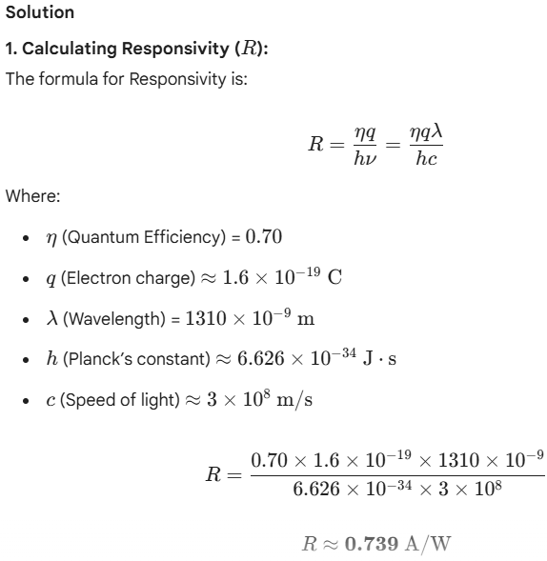
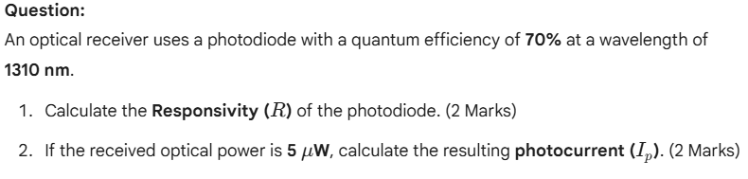
Exercise: Optical Detector Performance

Slide 6
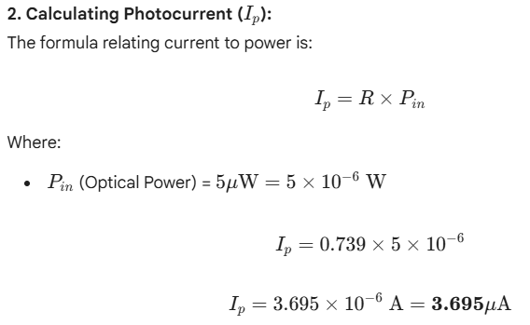
Exercise: Optical Detector Performance

